Slide 1

Overview
Use case: Visualisations of a ticket website data
Feb 2024

Slide 2
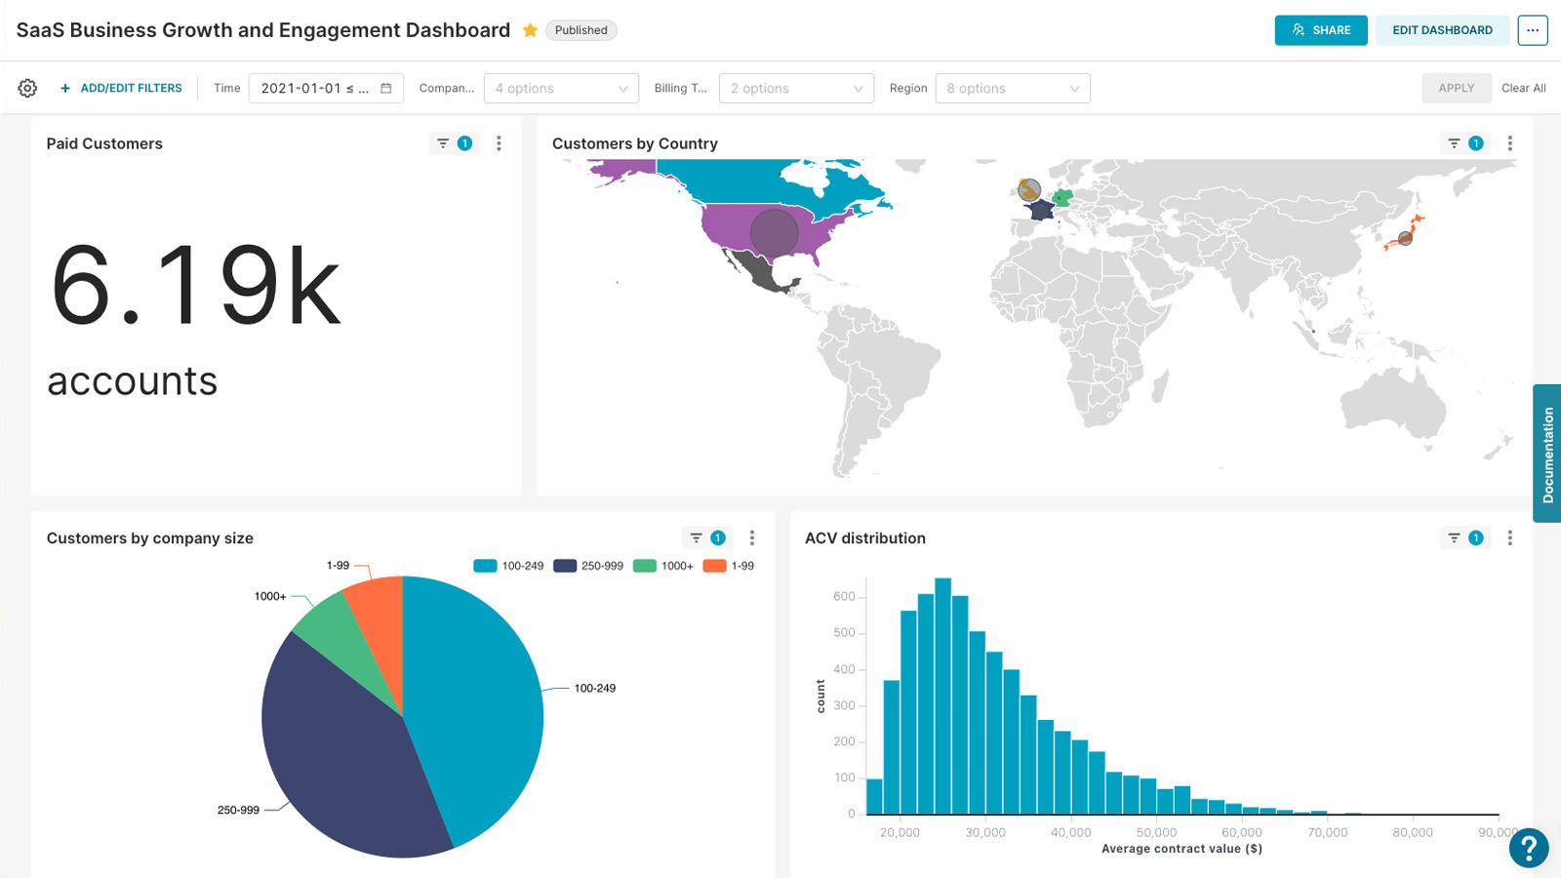
Overview
Apache Superset is a modern, enterprise-ready business intelligence web application.
It is built using a combination of Python for the backend and JavaScript for the frontend.
**Preset**

Slide 3
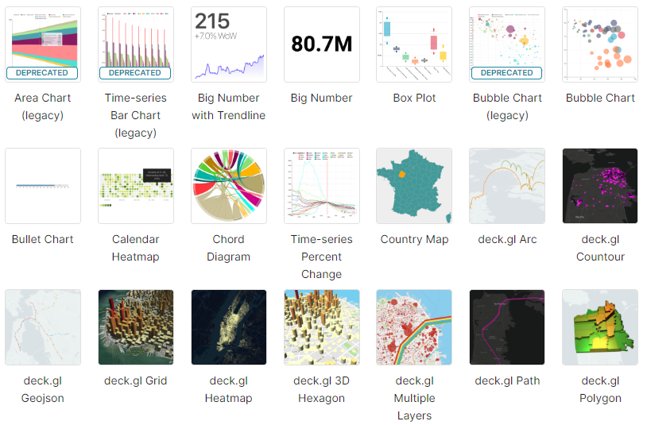
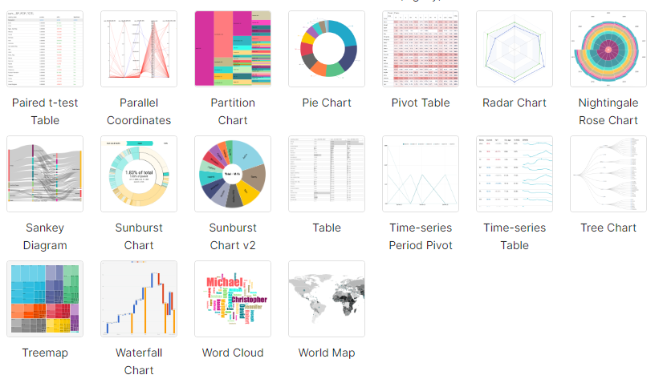
Started as a hackathon project at Airbnb in 2015.
Became open-source in 2016.
Joined to incubator program in 2017.
Announced as top-level project by the Apache Software Foundation in 2021.
Today, users with different abilities can analyze and visualize data on this platform, ranging from simple pie charts to detailed deck.gl geographic charts.

Slide 4
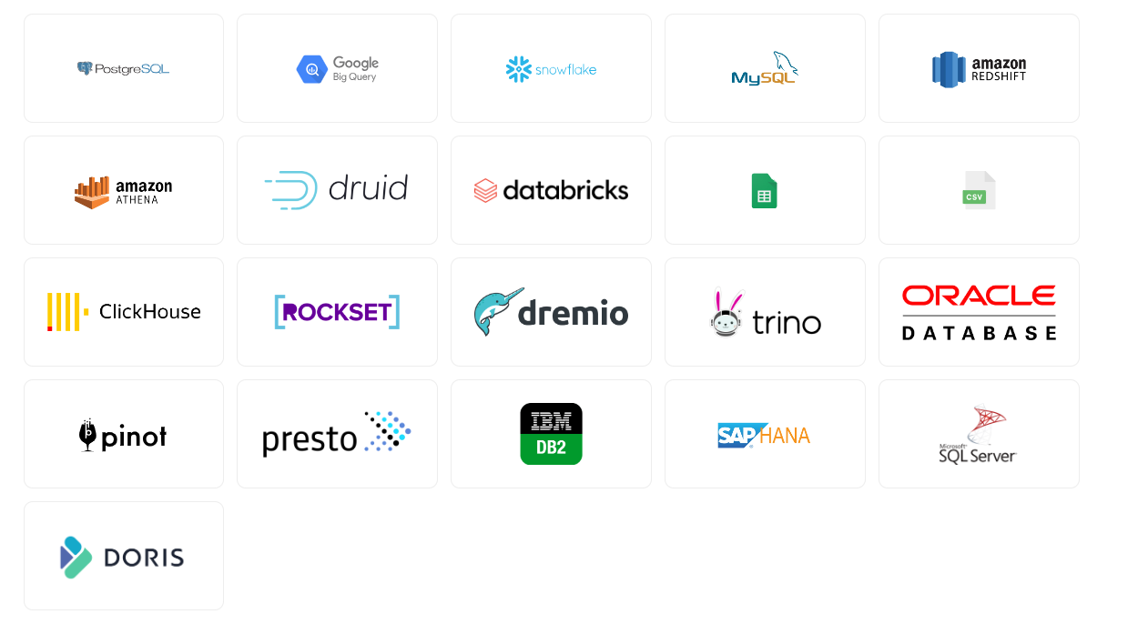
Supported Databases/Sources
…and more

Slide 5




Features
Alternatives
Powerful yet easy to use
Integrates with modern databases
Modern architecture
Rich charts and dashboards

Slide 6



Use Case
Up Superset & Postgresql containers
Configure Superset
Take a look at Superset interface
Create data source (TICKIT dataset)
Connect Postgresql & Superset
Create datasets
Create panel and charts
Windows

Slide 7
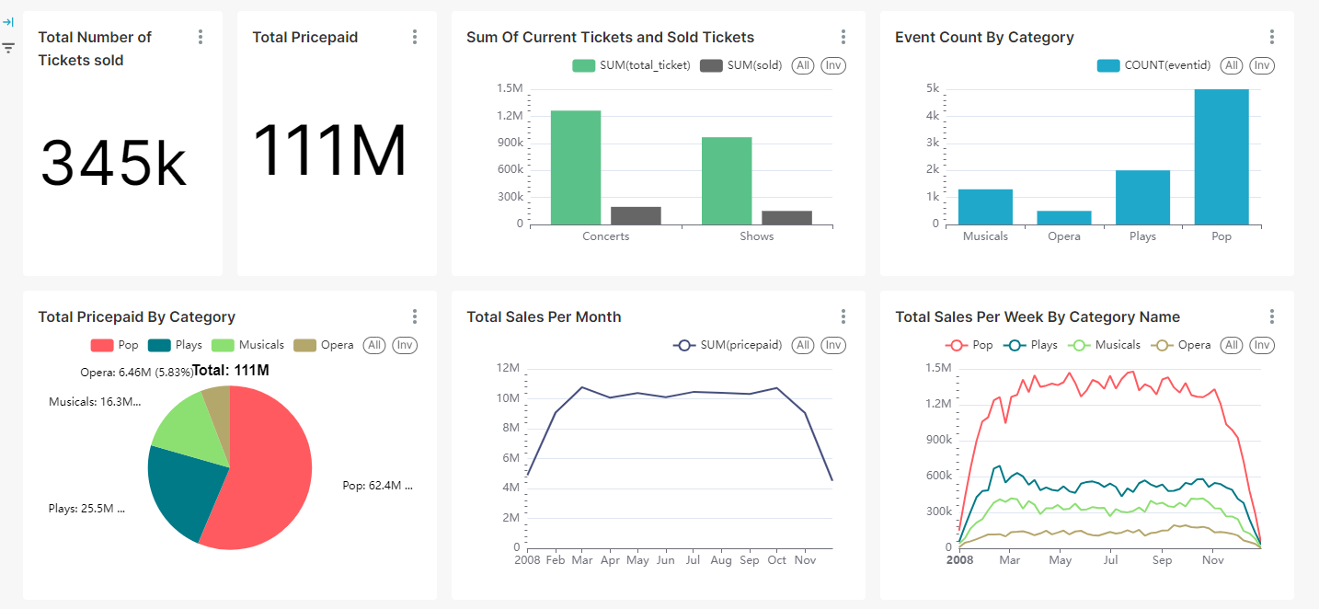
Output

